Slide 1
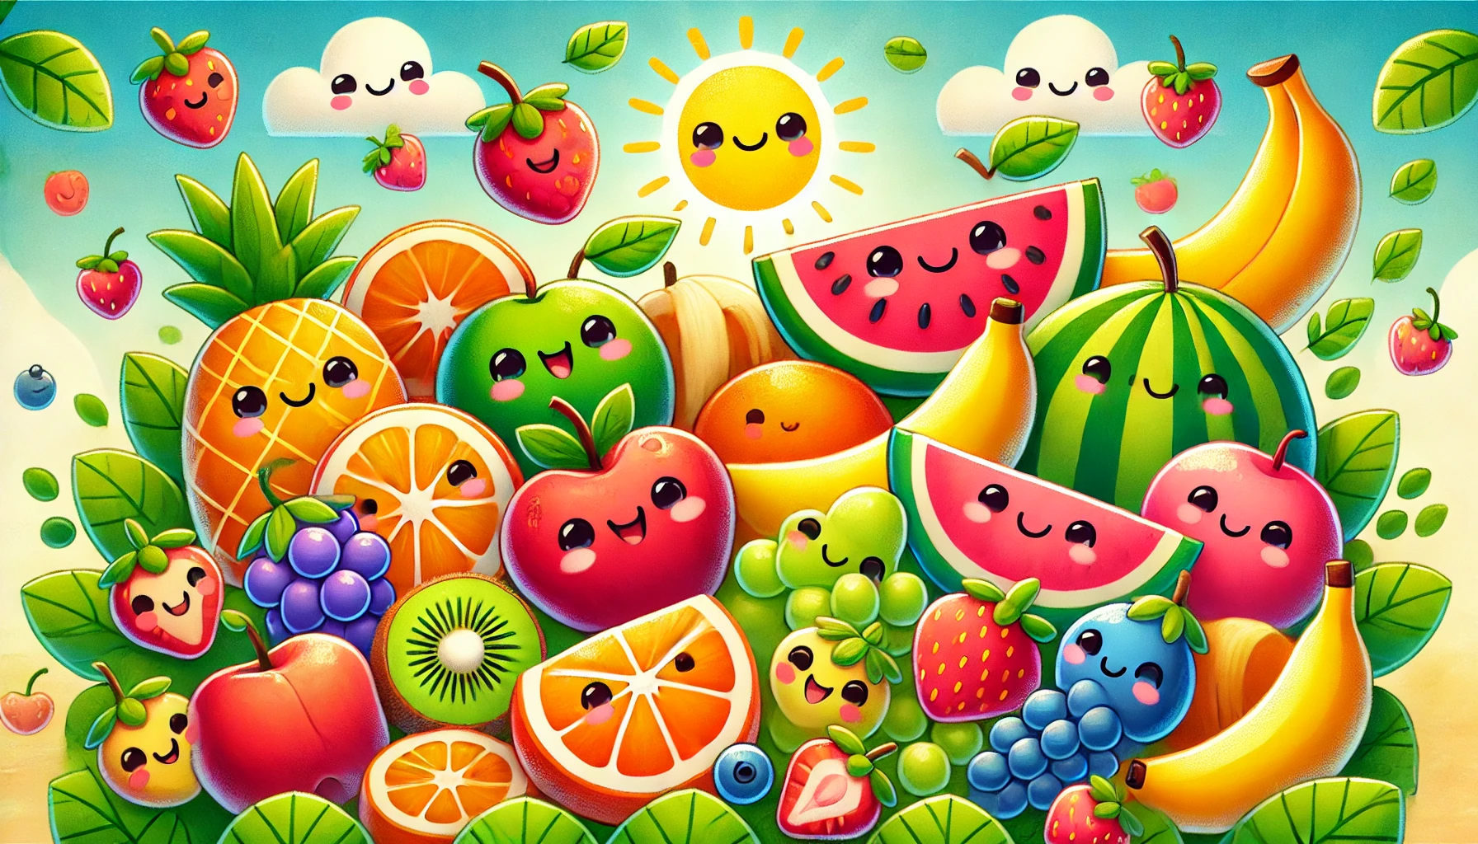
Little Healthy Artists
Coloring Book

Slide 2


Trace & Color
Fruits
Banana

Slide 3
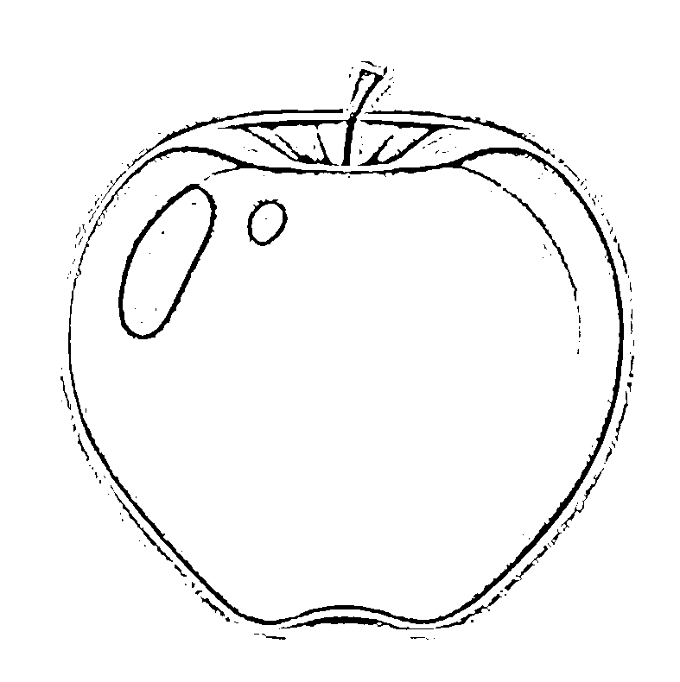

Trace & Color
Fruits
Apple

Slide 4


Trace & Color
Fruits
Pineapple

Slide 5
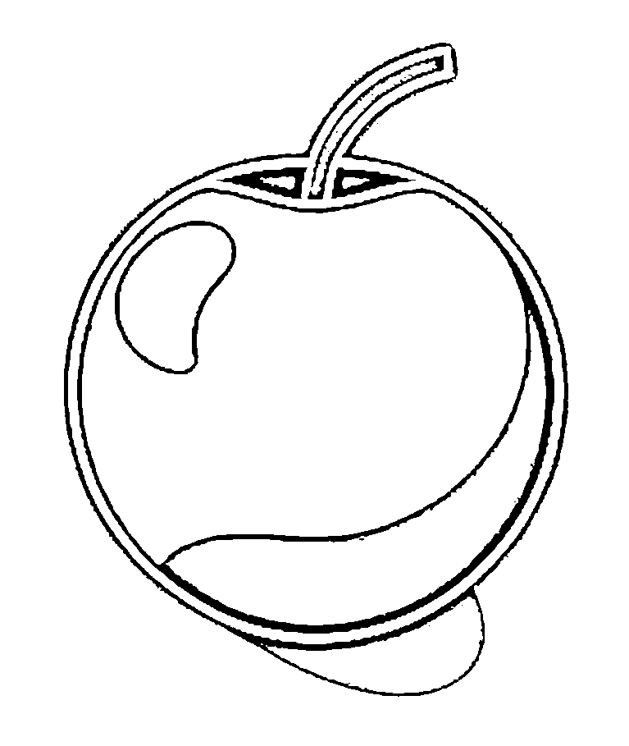
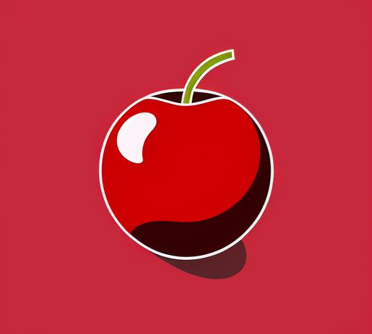


Trace & Color
Fruits
Cherry

Slide 6


Trace & Color
Grapes
Fruits

Slide 7
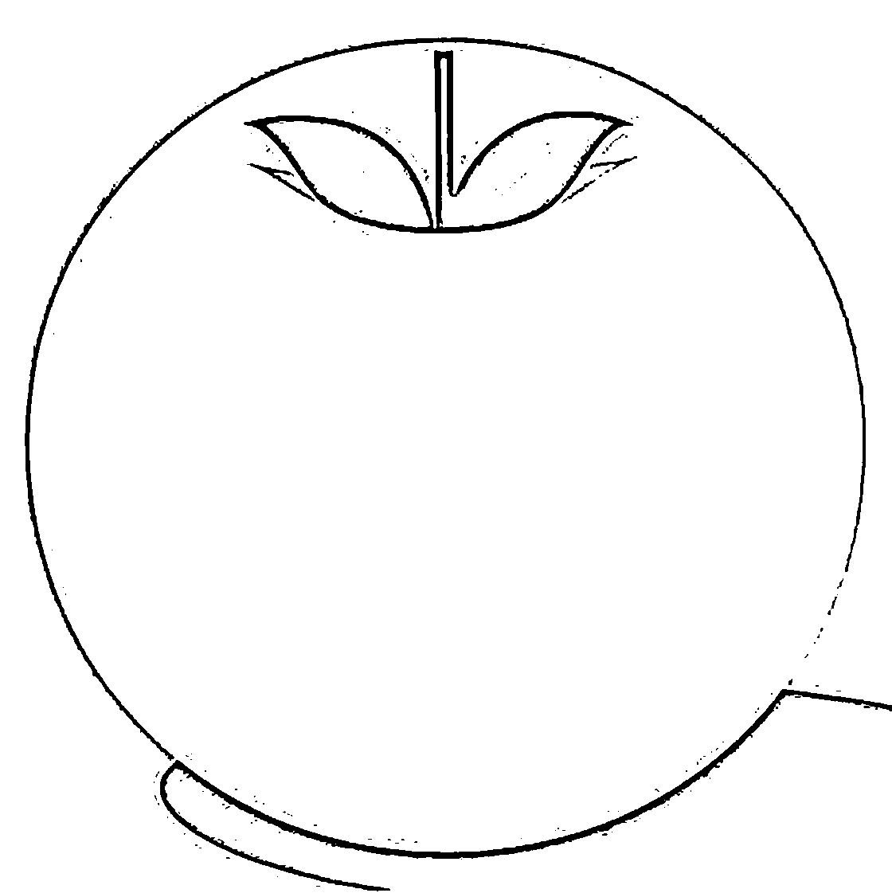

Trace & Color
Orange
Fruits

Slide 8


Trace & Color
Fruits
Peach

Slide 9
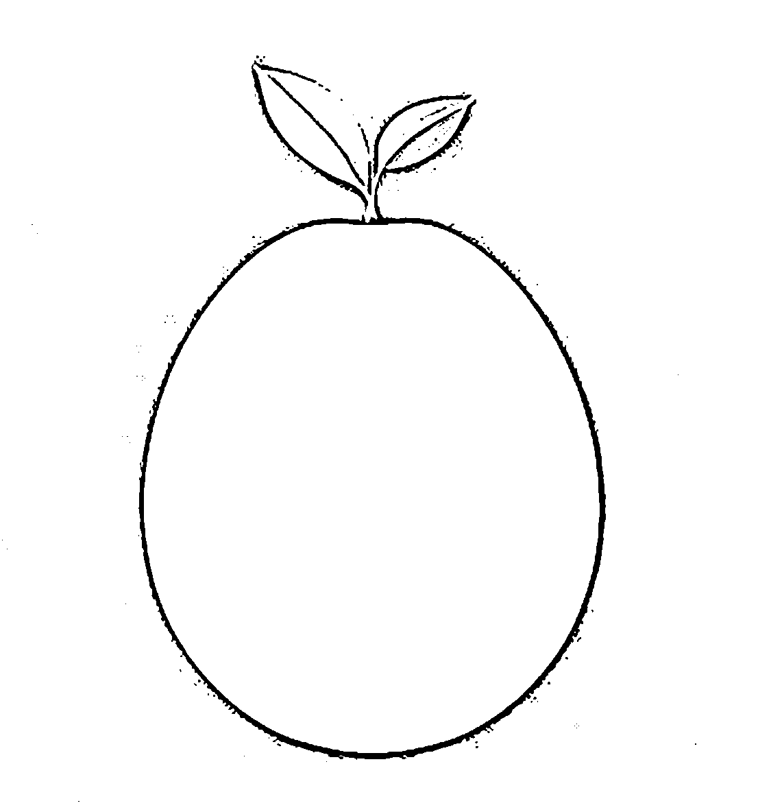

Trace & Color
Fruits
Mango

Slide 10
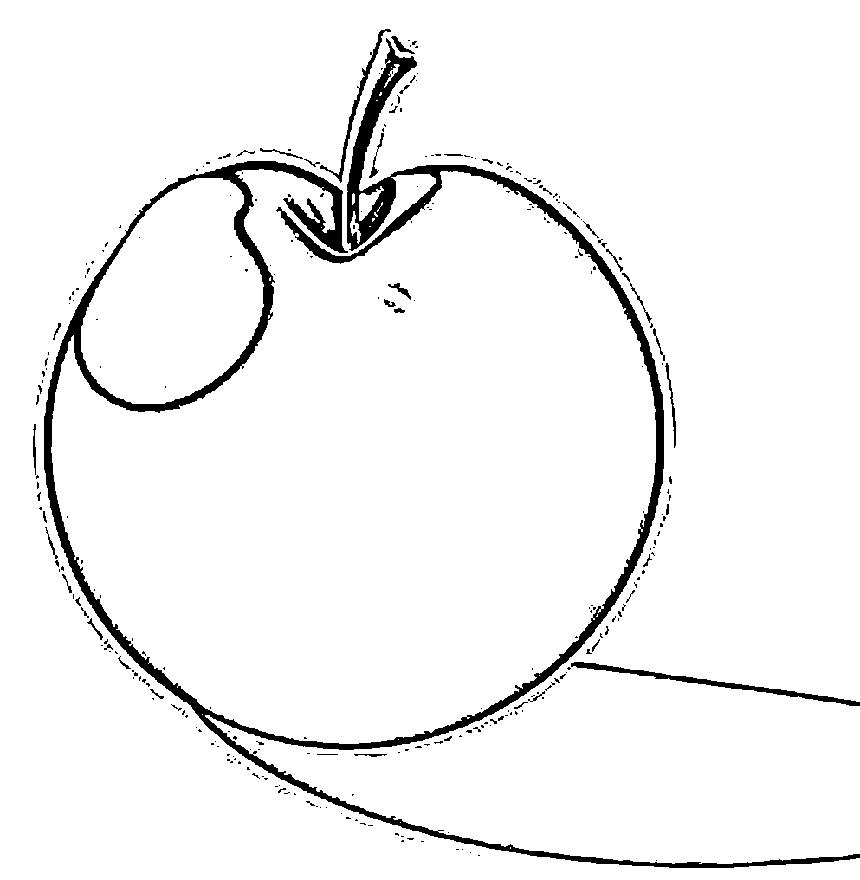

Trace & Color
Fruits
Plum

Slide 11
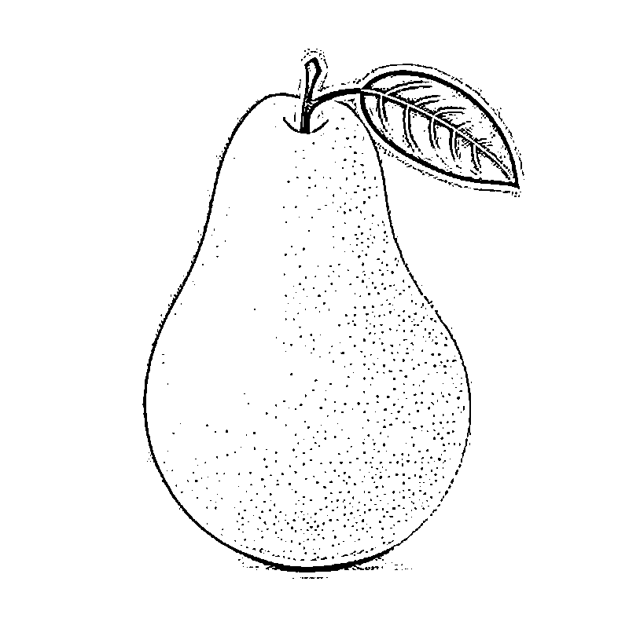

Trace & Color
Fruits
Pear

Slide 12


Trace & Color
Fruits
Strawberry

Slide 13


Trace & Color
Fruits
Watermelon

Slide 14


Trace & Color
Fruits
Avocado

Slide 15
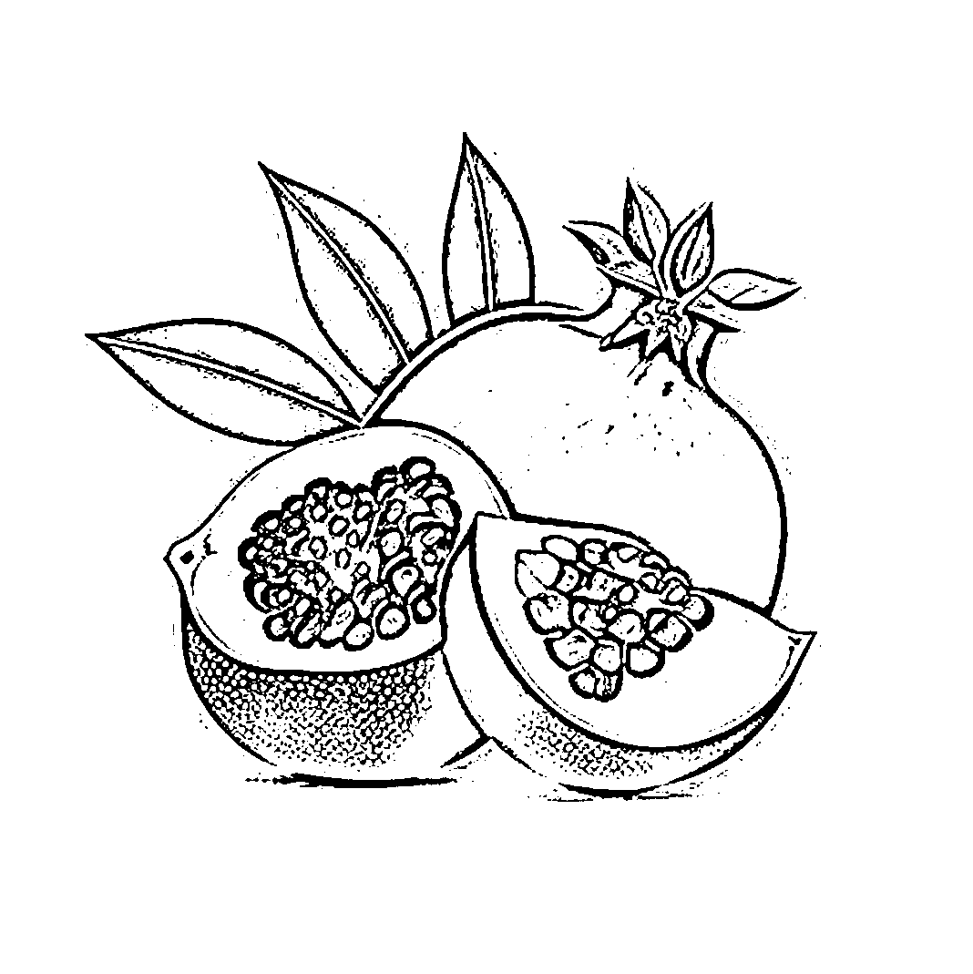
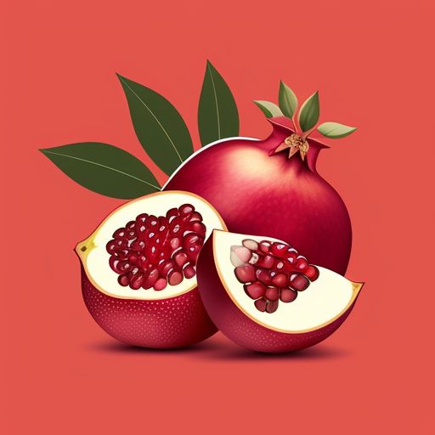

Trace & Color
Fruits
Pomegranate

Slide 16
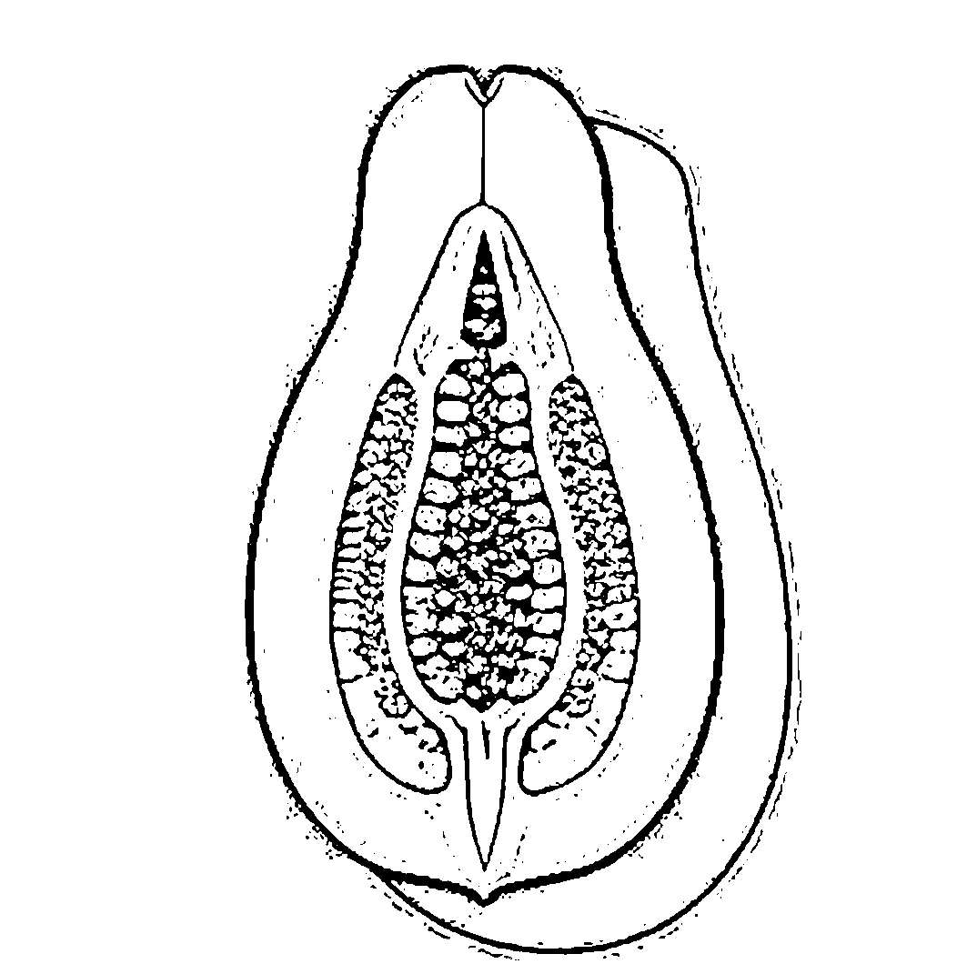
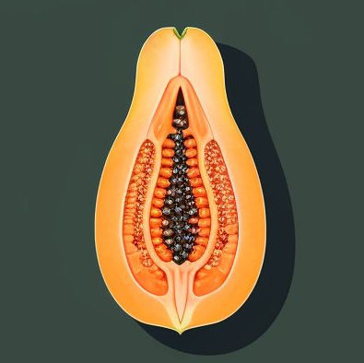
Trace & Color
Fruits
Papaya

